Slide 1
Objective & Agenda
01 | Why should you care about EI?
02 | What is Emotional Intelligence (short recap)
03 | Apply EI for Greater Impact
04 | Wrap Up
Course Goal/Objective:
To build on EI foundations by empowering learners with EI tools, insights & resources that result in greater impact in their roles.
We want learners to walk away with a tool that helps them self-assess and choose how they respond in a stressful situation.
Notes:
[This slide is for the presenter.]

Slide 2

Emotional Intelligence for Greater Impact
Workshop Presenter Deck
Notes:
Welcome!
[Introduce self]
How many of you are already familiar with EI?
How many of you were able to review the EI course from LinkedIn Learning?
My goal for you – walk away with something you didn’t know AND something you can apply in the real world.

Slide 3



Class Commitments
Turn on video – Participate, contribute, actively learn
Be present – Put away other devices, close other screens
Be open – Share your experience, ask questions
Notes:
Since this is a class on EI, we feel it’s important to turn on your video, so you can see each other and your reactions when interacting.
[click] You will get out of the class what you put into it, so give it your full focus.
[click] And please be open and speak up if you have questions.

Slide 4
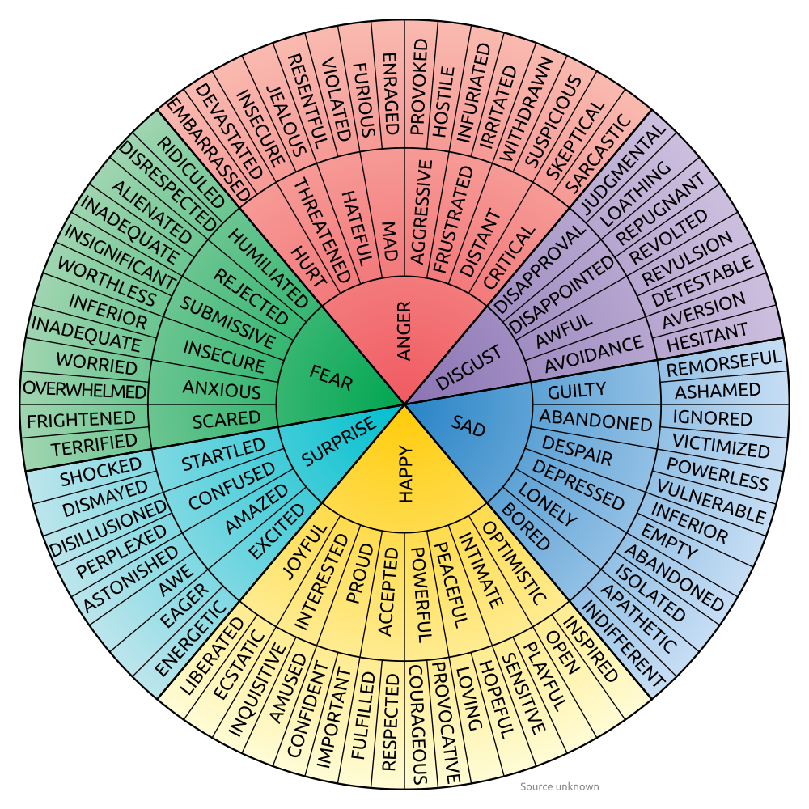

Self-Awareness
95% of people think they’re self-aware, but how many actually are?
10-15%
30-35%
45-50%
65-70%
Source: Tasha Eurich, Harvard Business Review (based on a 5-year study)
Notes:
We’re going to start with a poll. [Poll in Teams]
Based on a 5yr study of 467 working adults in the US…
[click] the answer is… [click] 10-15%
-NEXT SLIDE

Slide 5




Why care about Emotional Intelligence?
Higher Salary & More
Career Opportunities
Better Communication & Collaboration
Greater Job Satisfaction
Effective Leadership
People with high EI make an avg of $29k more per year than those with low EI.
People with high EI can leverage their ability to understand others’ feelings, perspectives and motivations to align efforts.
People with high EI are better at managing stress, building relationships, fostering a positive work environment and achieve goals.
People with high EI are able to inspire teams, build trust, and motivate team members.
Source: https://www.talentsmarteq.com/increasing-your-salary-with-emotional-intelligence/
Notes:
If the study results weren’t reason enough,
let’s talk about Why EI matters? It turns out, there many benefits to having high EI.
[click] Higher Salary & Career Opportunities
There’s a direct correlation between your EI and what you earn.
People with high EI also tend to excel in organizational politics and interpersonal aspects of work life
People with EI typically enjoy more career advancement and opportunities to grow in the organization.
[click] EI enables Better Communication & Collaboration
The ability to empathize and see things from other’s perspectives, especially, helps with both communication and collaboration.
[click] Greater job satisfaction
and experience less burnout. Better at managing stress, are more resilient.
In a climate where a lot of teams are doing more with less, fostering a positive environment with strong relationships makes handling challenges a little easier.
[click] Bolsters Effective Leadership
Leaders with high EI build trust and are able to motivate and even inspire their teams.
Emotional Intelligence is a skillset that is linked to higher job satisfaction, better performance, higher income and greater opportunities for career advancement.
High emotional intelligence fosters stronger relationships, effective communication, and better conflict resolution, as individuals are more attuned to the feelings and perspectives of those around them. In the workplace, EI contributes to teamwork, leadership, and decision-making by promoting collaboration and reducing misunderstandings.
Emotional Intelligence (EI) can significantly impact earning potential because it enhances interpersonal and professional skills that are highly valued in the workplace. Here's how:
Improved Relationships: High EI helps individuals build strong relationships with colleagues, clients, and supervisors. This fosters collaboration and trust, which can lead to better opportunities and promotions.
Effective Leadership: Leaders with high EI are better at understanding and managing their team's emotions, leading to increased productivity and team satisfaction. This often translates into higher salaries for emotionally intelligent leaders.
Conflict Resolution: People with high EI are skilled at navigating workplace conflicts, ensuring smoother operations and a more harmonious work environment.
Adaptability: High EI individuals can adapt to changes and handle stress effectively, making them valuable assets to organizations.
Additionally, individuals with high EI tend to excel in organizational politics and interpersonal aspects of work life, which are crucial for career advancement.

Slide 6






EI and Company Values
Be yourself.
Come as you are, be true to yourself, and bring original ideas. We are stronger because of our differences and the unique experiences each of us brings. We value individuality, diversity, inclusiveness, and equity.
Lift people up.
Operate with empathy and integrity. When we put people first, we build better relationships, trust, and resiliency. In turn, this sustains stronger communities.
Make an impact.
Take personal initiative, own the results, learn from mistakes, and always look to improve. When we commit to improve something every day, we positively impact individuals, businesses, and society.
Clients first.
Clients are our North Star. We strive to know their businesses as well as our own. We co-create and collaborate to grow businesses and relationships. When that happens, we all win.
Innovate, always.
See the bigger picture. Be bold, think big, and ask ‘what if’. We value brave ideas and insight that exponentially unlock new possibilities to better serve people throughout the property ecosystem.
Set the pace.
Operate with speed, agility, and purpose. We are the heartbeat of the property market, dynamically adapting and evolving the way the industry works for the better. We value the clarity, focus and energy it takes to be the industry leader.
Notes:
Now that we’ve talked a little about why you should care about EI,
let’s ground it in our company values.
As you look through our values, where do you see EI?
After team answers: Yes, as you all have called out…EI underpins ALL our Cotality values.
Next, we’ll get into what EI is.
[If needed, show how EI integrates into each core value...]
ex: Be Yourself - Self-Awareness is critical to upholding integrity;
lift people up - recognizing when others are struggling and responding with empathy and care;
Innovation - building space for psychological safety to share ideas without fear of judgement and receive constructive feedback...etc.
Take personal initiative (Make an impact) = Self-motivation
Own the results (Make an impact) = Accountability
Learn from mistakes (Make an impact) = Resilience/Adaptability
Always look to improve = Self-assessment, open to feedback

Slide 7

Emotional Intelligence Defined
The ability to recognize and understand emotions in yourself and others, and your ability to use this awareness to manage your behavior and build relationships.
Source: Daniel Goleman – Emotional Intelligence: Why It Can Matter More Than IQ
Notes:
First, who can tell us what emotional intelligence is? you can just say it or pop your thoughts into the chat
[Click for definition]
EI is the foundation for HOW WE SHOW UP in the workplace and in our lives.
Great thing about Emotional intelligence (EI) - it’s a skillset,
a set of competencies, which means that can be improved with practice.
People used to believe that employees should leave their emotions at the door, that they don’t belong in the workplace.
Companies now recognize the importance of EI. They understand people experience emotions at work, and they need to provide some tools and training, like this class.
Note: as we review skills in each competency, we’ve highlighted a handful of core skills, but there are others, and there are multiple EI models you may come across.
Transition: With that, let’s start with the first competency, Self-Awareness, and then apply it to an exercise.
It plays a significant role in professional success – as you saw earlier.
History: 1990 by researchers John Mayer and Peter Salovey
Daniel Goleman – Emotional Intelligence (Why it can matter more than IQ, 1995
Emotional Intelligence 2.0 – Geared for the workplace – by Bradberry & Greaves, 2009 – TalentSmart

Slide 8
Emotional Intelligence Competencies
Recognize your feelings in the moment - how they affect your body, thoughts & actions
Be honest with yourself about your strengths & growth areas
Understand your motivations
Recognize your tendencies across situations
Know your buttons or triggers
SELF-AWARENESS
E I
PERSONAL COMPETENCE
Sources: Daniel Goleman – Emotional Intelligence: Why It Can Matter More Than IQ and Emotional Intelligence 2.0, Bradberry & Greaves
Notes:
Remember in the poll only about 10-15% of people who thought they were self-aware actually were.
Another fun fact: in a different study involving over 500,000 people over 10 years, they found only 36% of people were able to accurately identify their emotions as they happen. [Emotion wheel]
(Source: Emotional Intelligence 2.0, Bradberry & Greaves)
Self awareness is the cornerstone of EI.
Self Awareness comes down to how well you know yourself. It’s your ability to recognize your feelings (when you’re feeling them),
and how they affect your body, thoughts, and actions.
-It’s important to remember emotions as neither good nor bad. They serve a purpose.
They’re how we respond to the world around us.
Over the course of human existence, emotions helped keep us stay safe or alive - and have helped us connect with others.
Self awareness is your ability to see yourself clearly, including strengths and areas for improvement, as well as what motivates you.
Self-Awareness is also recognizing your behavioral tendencies in different situations.
Another important part of self-awareness is knowing your buttons and triggers.
Transition: Next, we’re going to do an exercise to help increase self-awareness.
[Put handout in the chat]

Slide 9


Self-Awareness Exercise – 6 minutes
2
Instructions:
1. Look at the list of values and identify your top values (up to 5)
Think about what’s most important to you, who you are at your best, and who you strive to be.
2. Think about a time you lived your values (even if it was hard), which value showed up in that situation?
Source: Brene Brown – Dare to Lead
Notes:
[Individual exercise] – 6 minutes
We’re putting a handout in the chat.
[Handout - Page 2]
You’ve been given a list of values.
1. Read through them and select your top few values – no more than 5.
These should be values that define who you are or who you strive to be.
If you don’t see your value listed, write in your own.
2. Think about a time when you lived up to your values, which value was involved?
You’ve got 6 minutes.
Go ahead and put a thumbs-up in the chat when you’re done.
[1 minute (30 second) reminder.]
**Debrief
How did you find this exercise? Was it easy, difficult?
Can I get a couple volunteers who are willing to share their values and a time you lived them?
Mine are Integrity, trust and freedom (all kinds).
Great job, we’ll come back your values in a few minutes.
If additional prompts are needed:
Think of your most meaningful moments
What are you most proud of
Time when you were least satisfied
Ideal environment
1 minute notice…
Has everyone selected their values? We’ll refer back to these shortly.

Slide 10
Self-Awareness Exercise
Accountability | Efficiency | Job security | Risk-taking
Achievement | Equality | Integrity | Safety
Adaptability | Ethics | Intuition | Self-discipline
Ambition | Excellence | Kindness | Self-expression
Authenticity | Fairness | Knowledge | Self-respect
Balance | Faith | Leadership | Service
Being the best | Family | Learning | Stewardship
Belonging | Financial stability | Loyalty | Success
Camaraderie | Forgiveness | Making a difference | Teamwork
Caring | Freedom | Openness | Thrift
Collaboration | Friendship | Opportunity | Time
Commitment | Generosity | Optimism | Tradition
Community | Giving back | Order | Trust
Compassion | Grace | Patience | Truth
Competence | Gratitude | Peace | Understanding
Confidence | Growth | Perseverance | Uniqueness
Connection | Harmony | Personal fulfillment | Usefulness
Contribution | Health | Power | Vision
Cooperation | Honesty | Pride | Vulnerability
Context | Hope | Recognition | Wealth
Courage | Humility | Reliability | Well-being
Creativity | Humor | Resilience | Wholeheartedness
Curiosity | Inclusion | Resourcefulness | Wisdom
Diversity | Independence | Respect | Write your own:
Environment | Initiative | Responsibility
1. Look at the list of values and identify your top values. Limit to 5 or fewer.
Enter your answer here:
2. Think of a time you lived your values. Which value/s showed up in that situation?
Enter your answer here:
Source: Brene Brown – Dare to Lead
Notes:
[EXERCISE IN PARTICIPANT HANDOUT]

Slide 11
Can you stand up and say a few words?
You can work on it over the weekend.
Per my last email…
We need to talk.
Can you come to my office?
Rush hour traffic
Notes:
We’re going to shift gears here a little…
When you see these scenarios on the screen, how do they make you feel?
You can say it out loud or put it in the chat.
[Anxious, tense, irritated, afraid?]
Now imagine how you’d respond to these scenarios.
Did anyone have trouble imagining how they’d respond?
These relate to knowing your behavioral tendencies across different situations,
which can help us be better prepared when they happen.
[Go to next slide]

Slide 12

Emotional Triggers in the Workplace
Triggers are situations, events, or interactions that evoke strong emotional reactions.
Notes:
But sometimes things happen at work that produce bigger emotions that can take us by surprise.
This is where we get into emotional triggers.
[Click] Triggers are situations, events, or interactions that evoke strong emotional reactions.
We’re often blindsided by our reactions and unaware of the root cause.
Emotional triggers are related to our past experiences (even if we don’t remember them).
Something in the current situation feels similar to something from our history,
and that brings up a well of emotions.
In the context of this class, triggers, like emotions, are also not good or bad,
they just happen sometimes, because we’re human.
Next, we’re going to do a self-reflection exercise using your values (from the first exercise).

Slide 13

Self-Reflection – 5 minutes
3
Instructions:
Look at the list of your top values.
Think of a time (related to work) when you had a strong emotional response to something. Was it related to a top value?
What’s one way you know people can push your buttons or trigger you?
Notes:
[Handout P3] – 5 mins
For this exercise, I want you to think of triggers as they relate to your personal values.
Think of a work-related situation where you had a strong emotional response.
When you look at it closely, can you relate it to one of your values? If so, which one?
Knowing your values, what’s one way people can push your buttons or trigger you?
You’ve got 5 minutes - Put a thumbs up in the chat when you’re done.

Slide 14

Self-Reflection - Debrief
What did you learn in this exercise?
Notes:
What did you learn about yourself in that exercise?
Does anyone want to share?
Were you surprised by your answers?
The purpose of doing these exercises –identifying your values and knowing your tendencies – is that it allows you to manage your responses more effectively.
[Next slide]

Slide 15
Emotional Intelligence Competencies
Recognize your feelings in the moment - how they affect your body, thoughts & actions
Be honest with yourself about your strengths & growth areas
Understand your motivations
Recognize your tendencies across situations
Know your buttons or triggers
SELF-AWARENESS
SELF-MANAGEMENT
E I
PERSONAL COMPETENCE
Ability to choose how you respond in situations, despite heightened emotions or stress
Assume positive intentions
Drive results
Remain resilient & adaptable to change
Sources: Daniel Goleman – Emotional Intelligence: Why It Can Matter More Than IQ and Emotional Intelligence 2.0, Bradberry & Greaves
Notes:
Which brings us to the 2nd competency - Self-Management.
Self-Management is your ability to CHOOSE how you respond in the moment in different situations.
This includes times when we have strong emotions, when we’re under pressure, and even when we’re triggered.
It includes making the choice to give people the benefit of the doubt.
When you start from a place of assuming positive intent on the part of others, you’re much more likely to stay calm in potential conflict situations.
We saw driving results, learning from mistakes, and keeping yourself motivated in the Cotal values,
Ability to remain resilient, despite setbacks and consistent change.
Transition: Some might be thinking this sounds good,
but HOW can we CHOOSE how we respond to situations,
especially when we’re caught off guard by our own emotions in those moments?
Transition: We’re going to provide you with a couple things right now you can use to help with self-management.

Slide 16
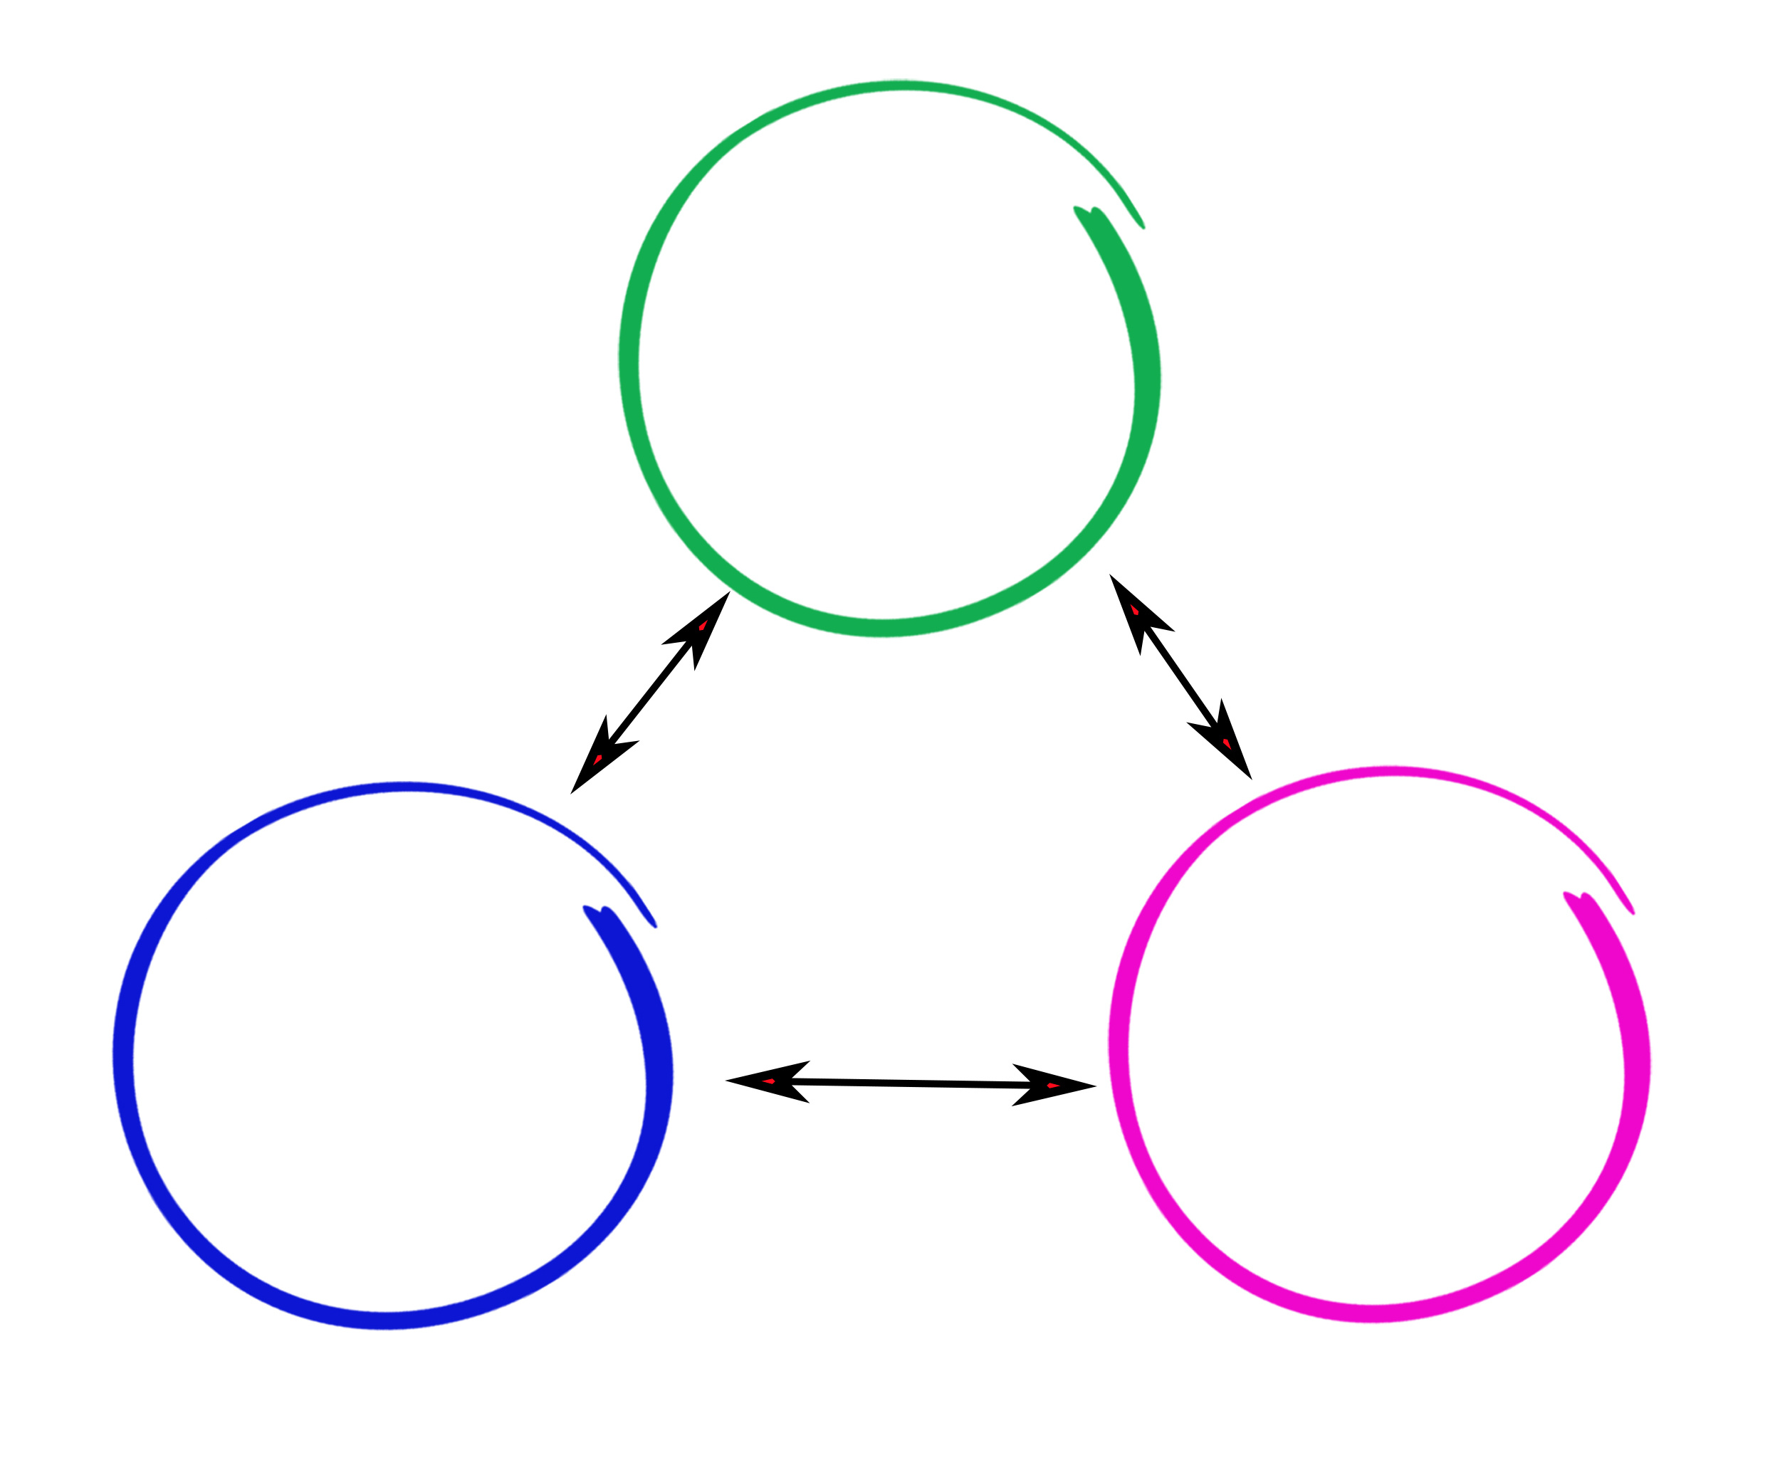
Cognitive Triangle
Thoughts/ Beliefs
What we tell ourselves
Behavior
What we do
Emotions
What we feel
Notes:
To lay the groundwork for the exercise, I wanted to show you something used in Cognitive Behavioral Therapy to help people understand and change their patterns of thinking that are negatively affecting their emotions and behaviors.
The idea is that our thoughts/beliefs, emotions, and behavior
are all interconnected and influence each other.
Now, let’s apply this. [next slide]

Slide 17


ABCDE Reframing Method
Activating Event
A
What happened to trigger the emotional response?
B
Beliefs
Identify the underlying beliefs/thoughts you have about the event
C
Consequences
Note the emotional & behavioral consequences of your belief/thought
D
Dispute & Reframe
E
Challenge/dispute the irrational or negative beliefs
Effects
Observe the positive effects of reframing and adopt rational, adaptive beliefs
Notes:
The ABCDE Reframing method can be really helpful for examining our underlying beliefs or thoughts and REFRAMING them to change our responses.
We’re going to walk through an example together, then you’ll do a group exercise where you apply the method.
A - Activating Event:
Identify the event or situation that triggered your emotional response.
Example: A colleague criticizes your work during a meeting.
B - Beliefs:
Reflect on the beliefs or thoughts you had about the event.
Our beliefs and thoughts feed into our emotions, which affect our behavior.
Example: “People are going to think I'm incompetent.“
C - Consequences:
Note the emotional and behavioral consequences of your beliefs.
Example: Feeling anxious and avoiding future meetings.
D – Dispute & Reframe – We are our worst critics and some have negative self-talk.
Challenge and dispute irrational or negative beliefs.
Example: “People don’t think I'm incompetent? Maybe the criticism was constructive“
E - Effects:
Observe the positive effects of adopting rational and adaptive beliefs.
Example: Feeling more confident and open to feedback.
[Next slide]

Slide 18
ABCDE Reframing Method
Activating Event
A
Ex. A colleague criticizes your work during a team meeting.
B
Beliefs
Ex. “People are going to think I’m not good at my job."
C
Consequences
Ex. Feeling anxious, avoiding future meetings or stop speaking up
D
Dispute & Reframe
E
Ex. People don’t think I’m bad at my job, maybe I can learn from the feedback
Effects
Ex. Feeling more confident and open to feedback
Notes:
The ABCDE Reframing method can be really helpful for examining our underlying beliefs or thoughts and REFRAMING them to change our responses.
We’re going to walk through an example together, then you’ll do a group exercise where you apply the method.
A - Activating Event:
Identify the event or situation that triggered your emotional response.
Example: A colleague criticizes your work during a meeting.
B - Beliefs:
Reflect on the beliefs or thoughts you had about the event.
Our beliefs and thoughts feed into our emotions, which affect our behavior.
Example: “People are going to think I'm incompetent.“
C - Consequences:
Note the emotional and behavioral consequences of your beliefs.
Example: Feeling anxious and avoiding future meetings.
D – Dispute & Reframe – We are our worst critics and some have negative self-talk.
Challenge and dispute irrational or negative beliefs.
Example: “People don’t think I'm incompetent? Maybe the criticism was constructive“
E - Effects:
Observe the positive effects of adopting rational and adaptive beliefs.
Example: Feeling more confident and open to feedback.
[Next slide]

Slide 19

Group Exercise – 5 minutes
4
Apply the ABCDE model to the scenario below.
You have been working hard on a project for weeks. During a team meeting, your manager points out several issues with your work and suggests changes. You immediately feel embarrassed and start to think that you are not good enough for the role.
A Activating Event | What happened to trigger your emotional response?
B Beliefs/ Thoughts | Identify the underlying beliefs/thoughts you have about the event.
C Consequences | Note the emotional & behavioral consequences of your belief/thought.
D Dispute & Reframe | Challenge the irrational or negative belief/thought and reframe it.
E Effects | Observe the positive effects of reframing and adopt rational, adaptive beliefs
Notes:
Time: 5 (8) minutes
Breakout groups of 3.
We’re going to put you in breakout groups, where you’re going to apply the ABCDE method for the scenario shown.
This exercise helps you reframe your thoughts and manage emotions effectively, fostering emotional growth.
You’ve got 5 minutes.
Debrief:
Use the framework to examine a past experience and uncover beliefs or thoughts.
Think of how you’d do it differently.
With practice, you can use this IN THE MOMENT you realize you’re having a strong response, so you can DECIDE how to respond.
[Go back to SL 18 during the exercise]

Slide 20
Emotional Intelligence Competencies
Recognize your feelings in the moment - how they affect your body, thoughts & actions
Be honest with yourself about your strengths & growth areas
Understand your motivations
Recognize your tendencies across situations
Know your buttons or triggers
Actively identify how others are feeling (body language, tone, facial responses)
Be curious, ask if in doubt
Working to learn others’ perspectives, what do they care about
Ability to “read the room” and pickup on subtle cues
SELF-AWARENESS
SELF-MANAGEMENT
SOCIAL AWARENESS
E I
PERSONAL COMPETENCE
SOCIAL COMPETENCE
Ability to choose how you respond in situations, despite heightened emotions or stress
Assume positive intentions
Drive results
Remain resilient & adaptable to change (Cotality values)
Sources: Daniel Goleman – Emotional Intelligence: Why It Can Matter More Than IQ and Emotional Intelligence 2.0, Bradberry & Greaves
Notes:
The 3rd competency of EI is where we shift focus from ourselves to others.
1. It’s about working to identify how others are feeling.
ASK: What’s the hardest part of that? [put in chat]
2. The 2nd bullet reminds to ask questions – don’t assume you know answer.
It requires paying attention and being present in conversations.
ASK: What are some ways you use to check in with others? [put in chat]
3. To be socially aware, you need to Listen with empathy and work to understand
where other people are coming from, especially when you don’t agree.
ASK: What’s the importance of learning other people’s perspectives? [put in chat]
When you’re in tune with how others feel and think,
you communicate more effectively and respond appropriately.
We’ve called out the skill of being able to read the room. [put in chat]
ASK: Who can tell us what this means & why is it important to be able to it?
How are people interacting? What’s the mood? Does their behavior change when someone else joins in.
Is there someone the others treat differently, and why? Who holds the power in the room?
[Can learn culture of a group or team, let’s you know how to appropriately respond]
Transition: Thank you all for sharing your knowledge with the group!
To open up an emotional check-in:
“How are you really feeling about this?”
“What’s your gut reaction to all of this?”
“What’s weighing on your mind most right now?”
“I’m curious—what’s your biggest concern or worry at this point?”
To clarify or deepen understanding:
“Can you tell me more about what’s behind that feeling?”
“What part of this is feeling most frustrating (or exciting) to you?”
“It sounds like you’re feeling [insert emotion]—is that right?”
“What’s been the hardest part of this for you?”
To check for emotional shifts or progress:
“Has anything changed in how you’re feeling about this since we last talked?”
“Are you feeling any differently now than when we started this conversation?”
“What’s giving you the most relief or optimism right now?”
To validate and show empathy:
“That sounds tough—how are you handling it?”
“I can tell this is meaningful to you. What’s the most important thing I should understand?”
“It seems like this brought up a lot—what would be most helpful for you right now?”
To help people self-reflect:
“How do you think this situation is affecting your energy or mood?”
“If you had to name one word to describe how you’re feeling right now, what would it be?”
“What’s one thing you need most right now—support, clarity, space?”
A good tip you might share is:
👉 Pause and reflect back what you’re hearing—sometimes just saying, “It sounds like you’re feeling overwhelmed by the pace of change,” can be a powerful emotional check-in tool by itself.

Slide 21

Emotional Intelligence Competencies
Recognize your feelings in the moment - how they affect your body, thoughts & actions
Be honest with yourself about your strengths & growth areas
Understand your motivations
Recognize your tendencies across situations
Know your buttons or triggers
Actively identify how others are feeling (body language, tone, facial responses)
Be curious, ask if in doubt
Working to learn others’ perspectives, what do they care about
Ability to “read the room” and pickup on subtle cues
SELF-AWARENESS
RELATIONSHIP
MANAGEMENT
SELF-MANAGEMENT
SOCIAL AWARENESS
E I
PERSONAL COMPETENCE
SOCIAL COMPETENCE
Create trust and show you value others
Make the effort to build strong bonds
Use your understanding of others to improve communication, effectiveness, align on goals
Adapt to others in the situation
Ability to choose how you respond in situations, despite heightened emotions or stress
Assume positive intentions
Drive results
Remain resilient & adaptable to change (Cotality values)
Sources: Daniel Goleman – Emotional Intelligence: Why It Can Matter More Than IQ and Emotional Intelligence 2.0, Bradberry & Greaves
Notes:
As we move into the 4th competency, think about how this group of skills relates to the other competencies.
Read through these, then we’re going to do a final exercise.

Slide 22

Relationship Management
Group Exercise
5
8 minutes
1. How can you ensure that you’re authentically building relationships using your awareness of yourself and others?
2. What are the top things you can do to adapt your demeanor to the people you’re with to achieve your shared goal?
Notes:
Time: 8-10 min
Breakout groups (4-5 people)
Final exercise – Let’s apply what you’ve learned so far.
Handout Page 5
We’ll put you in groups.
I want each group to be prepared to share one of your answers.
You have 8 minutes.
Debrief: Who’s willing to go first?
Tell us which question (1 or 2) and what your team’s answer was.

Slide 23

Applying EI at Work
Make the effort to get to build relationships with your coworkers. Ask questions to learn more.
Work to understand others’ perspectives, what they care about, how they prefer to communicate.
Pay attention to how your body responds to situations, and how others are feeling.
When you’re feeling triggered or getting stressed out, step back a moment, think of your values, and CHOOSE how you want to respond.
Utilize the ABCDE method to examine your thoughts and beliefs in trigger moments, challenge them to REFRAME.
Assume good intent – everyone is working toward the same goals. Find common ground.
Notes:
Here are some ways we’ve talked about for applying EI at work:
As you look through these, what stands out to you?
Which is the hardest one for you to do?
What do you think you do well?

Slide 24
Key Takeaways
What’s one thing you learned or will use from this course?
Notes:
As we wind down the workshop, I want you to write in the chat ONE thing you learned and will use from this course.
-Remember, ALL competencies require action from us – they are active skills that you can practice!
EI fosters stronger relationships, effective communication, and better conflict resolution.
EI contributes to teamwork, leadership, and decision-making
by promoting collaboration and reducing misunderstandings
[Next slide]

Slide 25
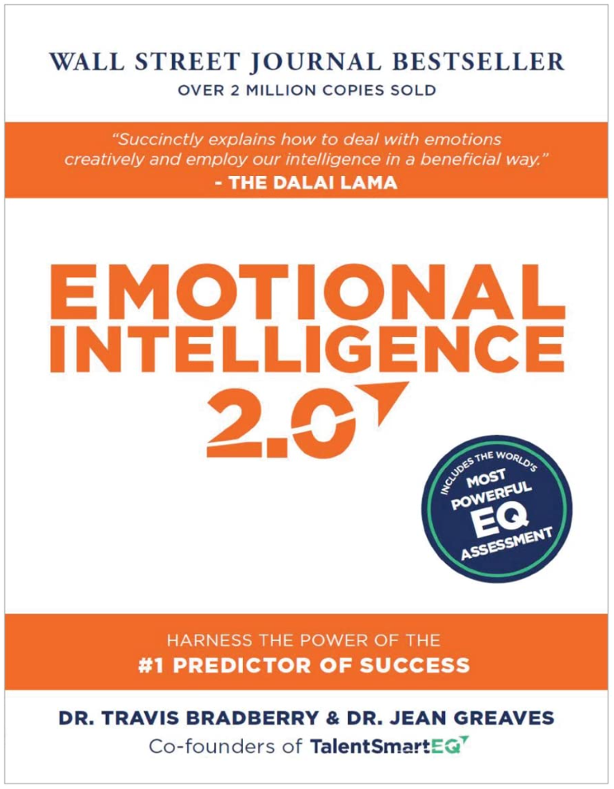
Additional Resources & Further Learning
Highly Recommended
Provides examples and LOTS of strategies for building EI!
Developing Your Emotional Intelligence – LinkedIn Learning (LIL)
Developing Organizational Awareness (LIL) – Excellent for building relationships
Building a Personal Brand That Can Boost Your Career -- Aspire recording in WD
Tips to Enhance Emotional Intelligence with Calming Exercises (LIL) – Great for dealing with stress
Leveraging Your Strengths (LIL) – Learn how to lean into your strengths
Additional New Aspire classes!
Influence Through Presence (Communication)
Strategic Collaboration
Growth Mindset in an Age of AI Transformation
Critical Thinking for Business Transformation
Notes:
These are some recommendations for further learning.
- Call out book.
- Call out new Aspire classes
We’ve included a copy of this with your handout.

Slide 26
Emotional Intelligence for Greater Impact
Thank you!
Notes:
We’ll be sending out a survey to get your feedback.
Since this is a new workshop, we want to ensure we make it the best we can.
We want to know what you thought worked well and what you think we can improve.
And thank you for attending!

